Slide 1
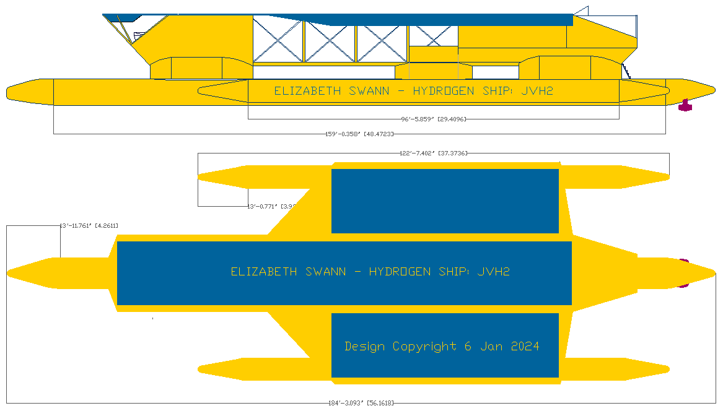
ELIZabeth swann
The Hydrogen powered (solar assisted) Zero Emission Water Transport
Z.E.W.T.
Presented by: Leo Perrin (Youth Project Lead)
https://elizabethqueenseaswann.com/

Slide 2
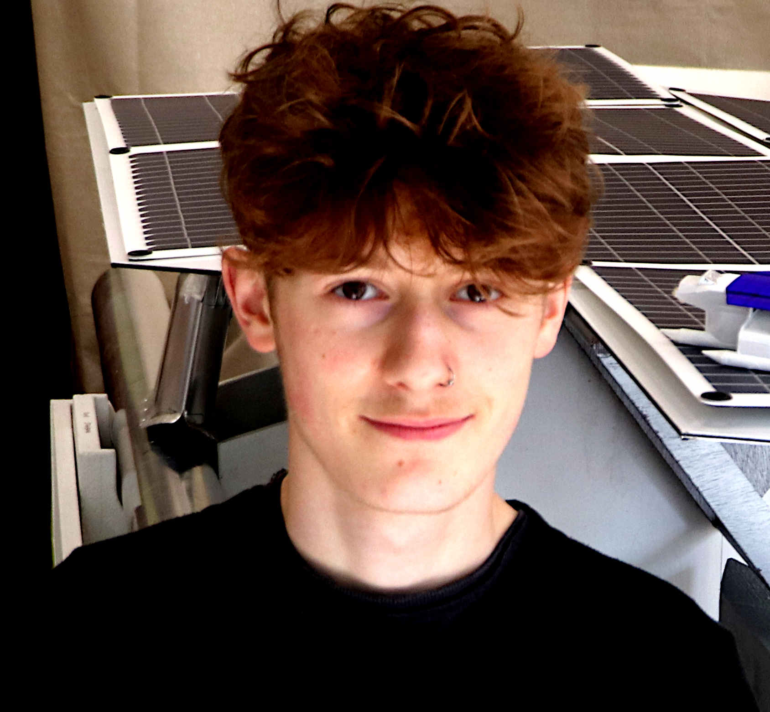
About me
I’m 15, Sussex based, convenient to the Foundation’s workshops in Herstmonceux. I’m a United Nations ocean ambassador.
I’m the Youth Project Lead on the Elizabeth Swann EU Clean Water Mission.
I study engineering and maths at Bexhill college. I also program computers.
I am very concerned with the current climate crisis.
https://elizabethqueenseaswann.com/

Slide 3
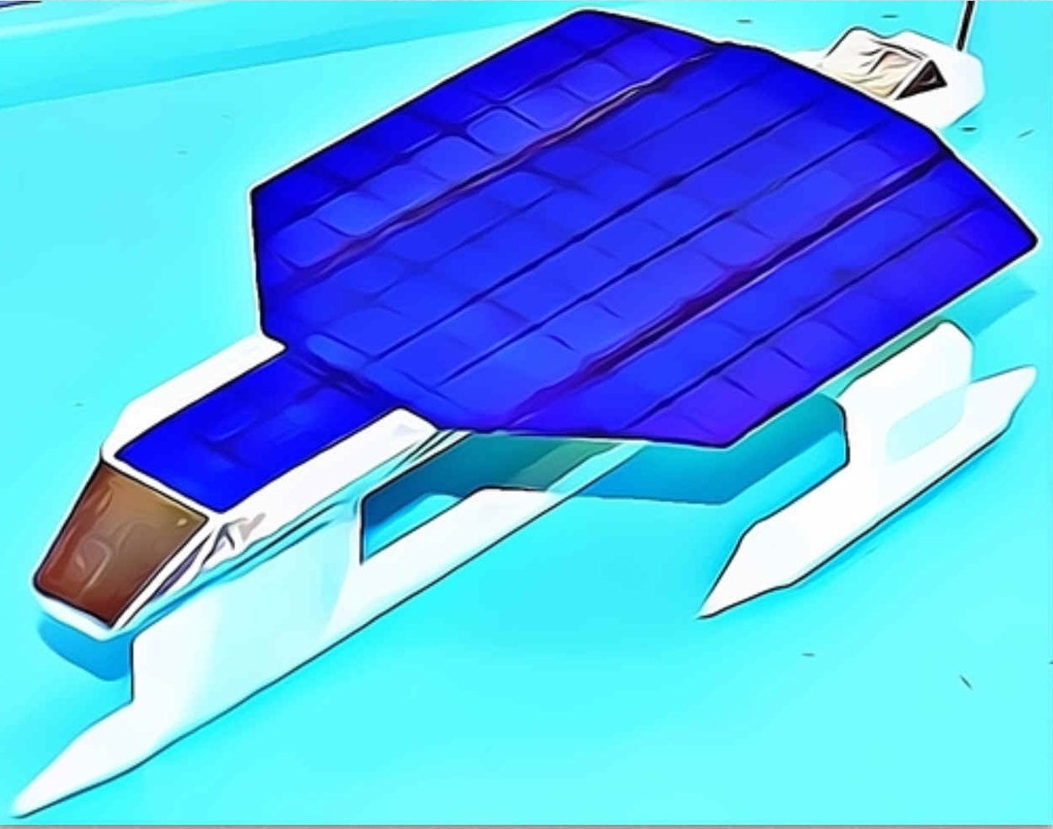
the elizabeth swann
The Elizabeth Swann is a 44 meter hydrogen powered trimaran with assistance from 370 square meters of solar panel capable of tracking the sun.
The picture is of a 1/200 scale model of the vessel.
https://elizabethqueenseaswann.com/

Slide 4
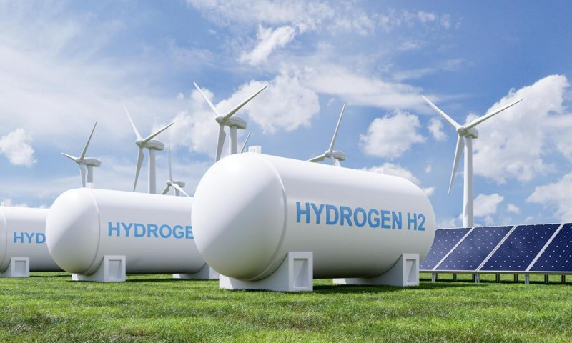
WHY HYDROGEN (METHANOL) ?
Hydrogen represents sustainable energy from nature. Combined with CO2 it makes methanol, a liquid fuel for transportation.
We can make hydrogen from water (H2O) using renewable electricity from wind turbines.
https://elizabethqueenseaswann.com/

Slide 5
OUR EU mission
The Elizabeth Swann project became an official EU Water Mission in 2023. The aim of which is to clean up rivers, seas and oceans. By introducing a hydrogen powered vessel that is zero carbon, we are showing the world that clean marine transport is practical.
The International Maritime Organization (IMO) has set targets for marine transport to be 50% zero emission by 2050.
We might show this is possible.
https://elizabethqueenseaswann.com/

Slide 6
JVH2
150 years ago in 1874, Jules Verne predicted that the world would one day be run on hydrogen.
Jules Verne also wrote a book called “Around the World in 80 Days.”
The ‘JVH2 Trophy’ is named in honour of Verne’s predictions. We will be entering the vessel to compete for the Jules Verne Hydrogen Trophy.
This Trophy is to be awarded to the fastest hydrogen powered ship to go around the world in under 80 days.
https://jules-verne.org/
https://elizabethqueenseaswann.com/

Slide 7
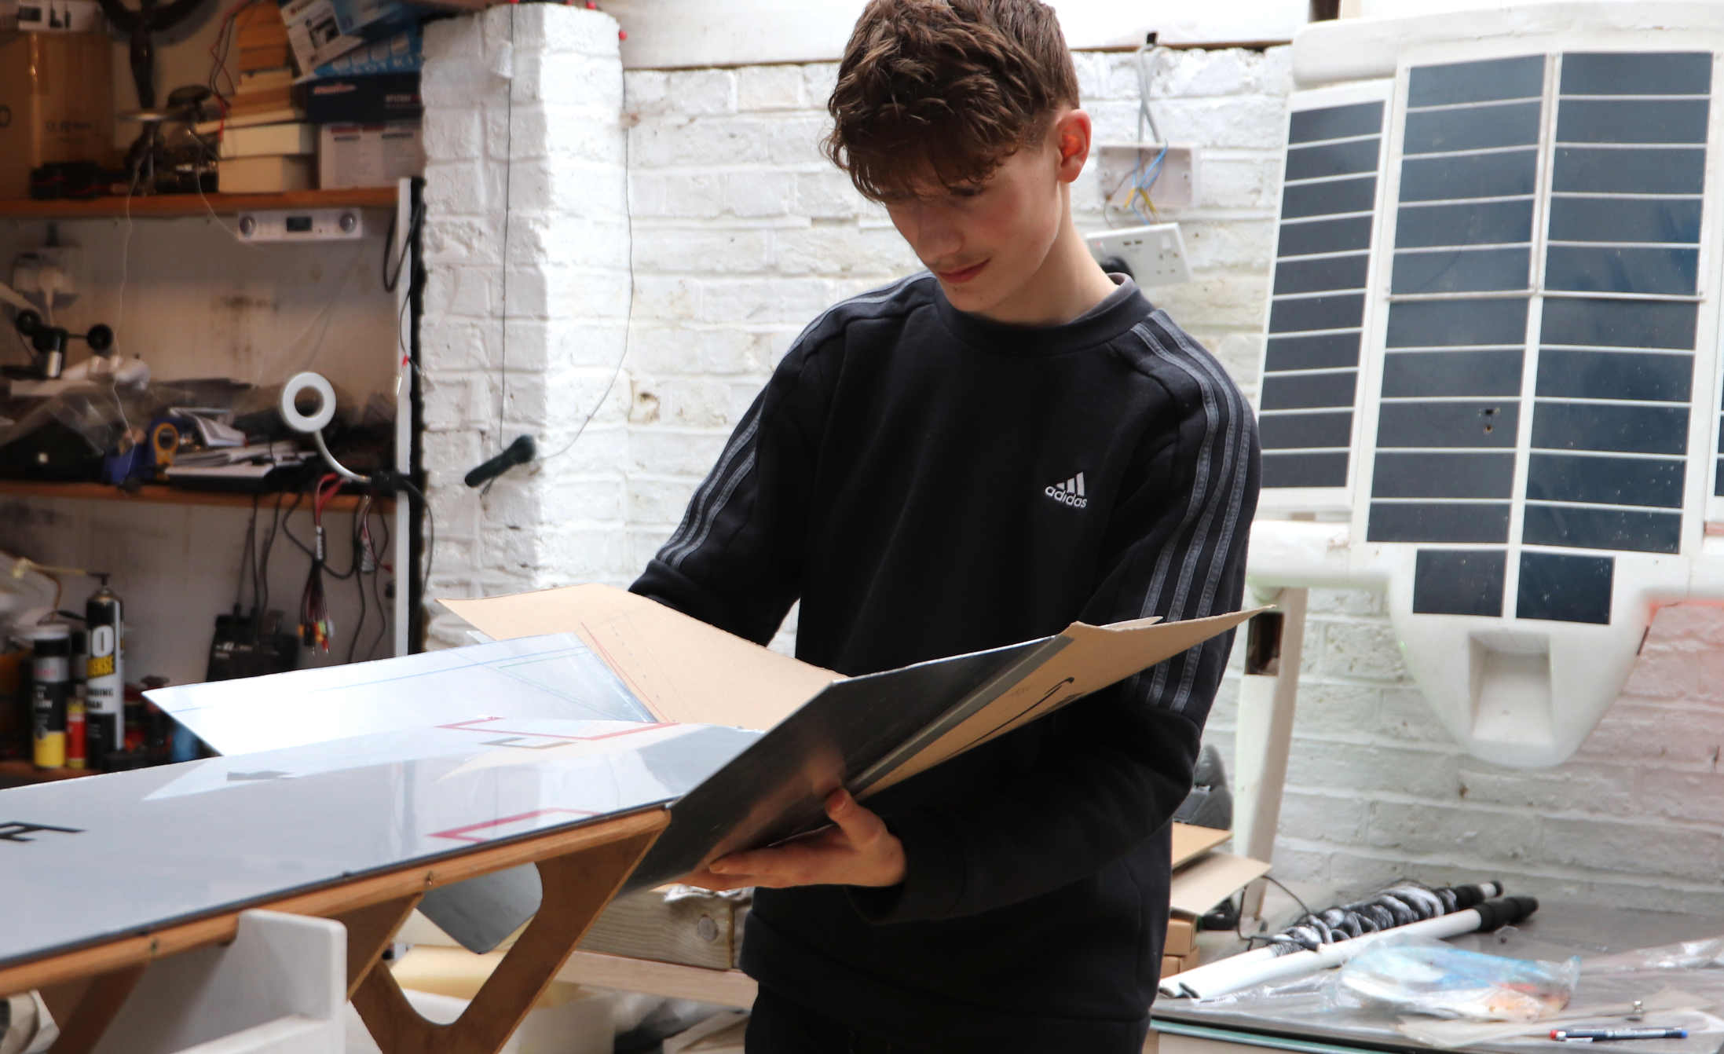
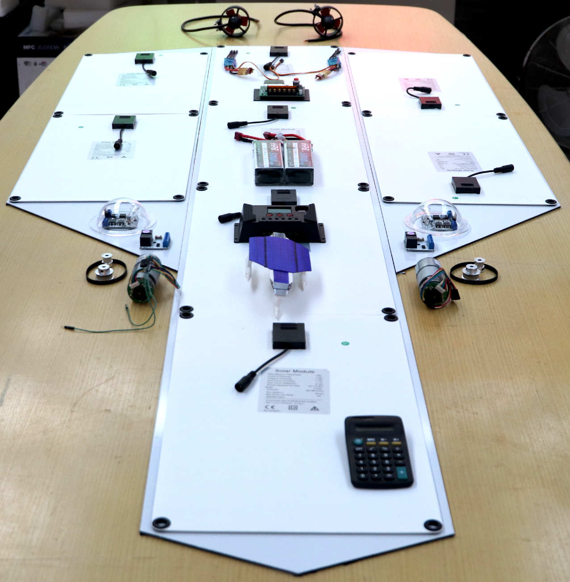
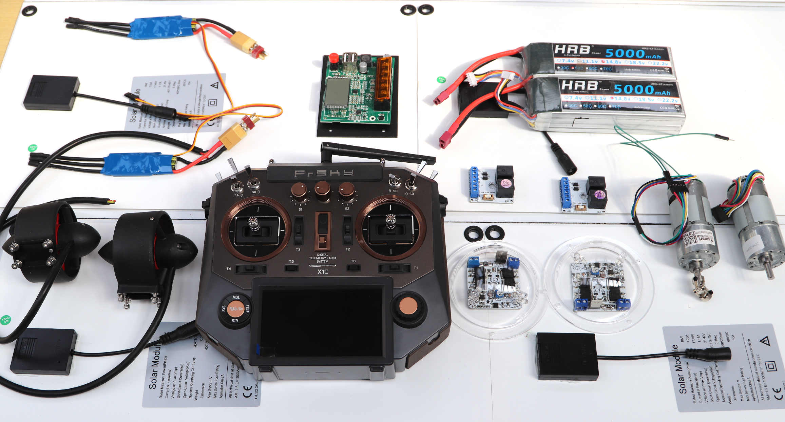
1/20th model – radio controlled
https://elizabethqueenseaswann.com/
We are currently working on this 1:20 scale - fully working - concept model.

Slide 8
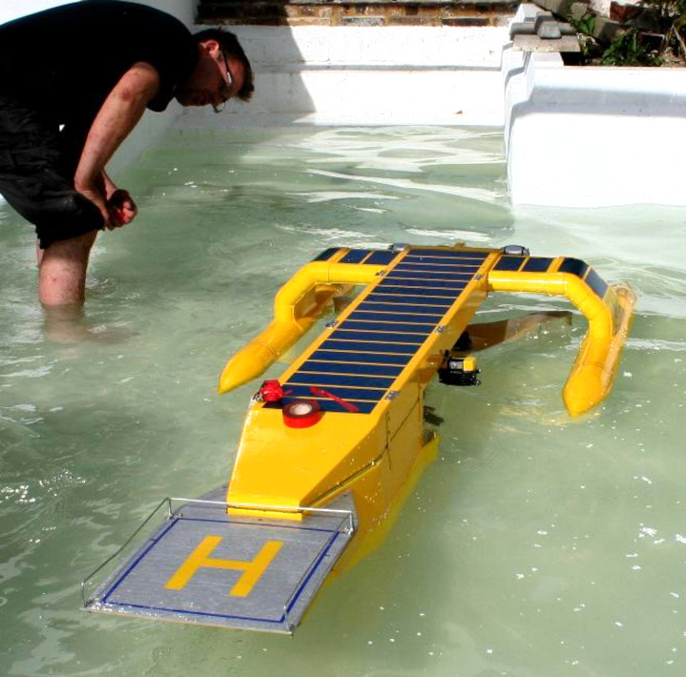
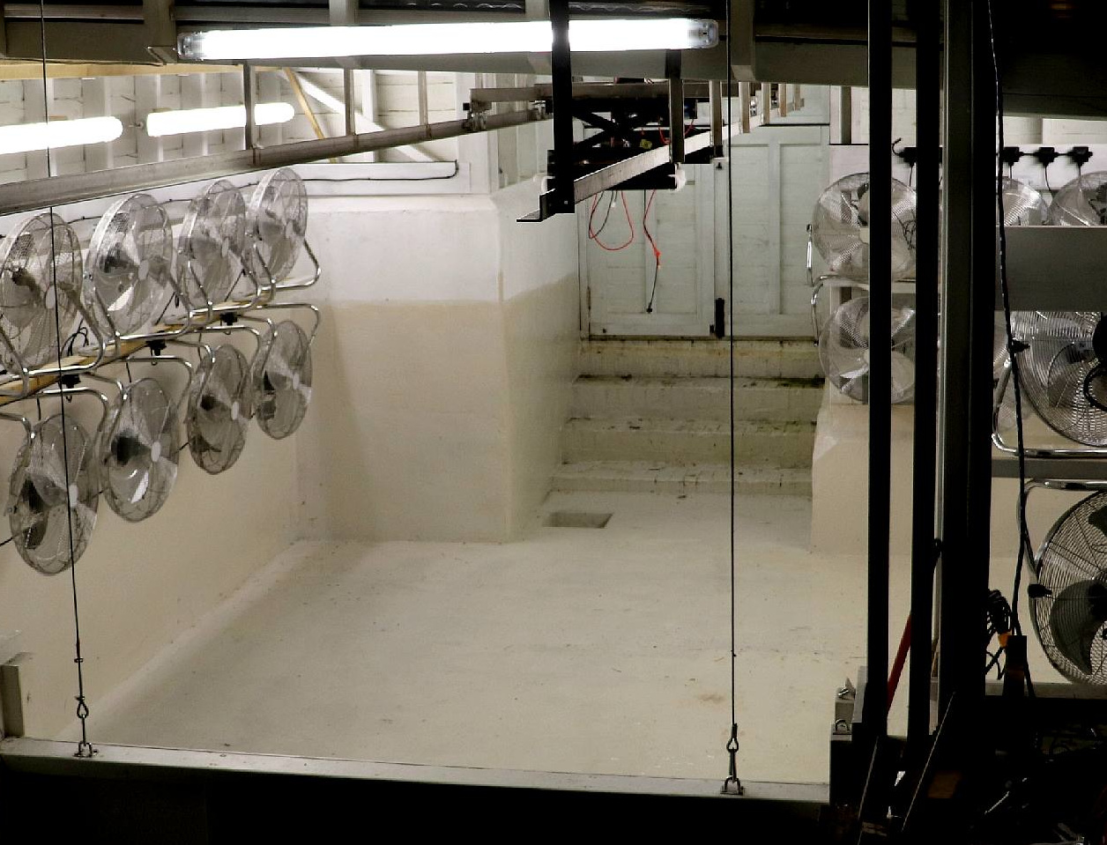
OUR TEST TANK
We can create hurricane sea conditions using these fans.
The facility helps us improve seakeeping and reduce hull drag, to be more efficient - so using less fuel.
https://elizabethqueenseaswann.com/
This is the world’s smallest water basin, seen here with another ship being tested.

Slide 9
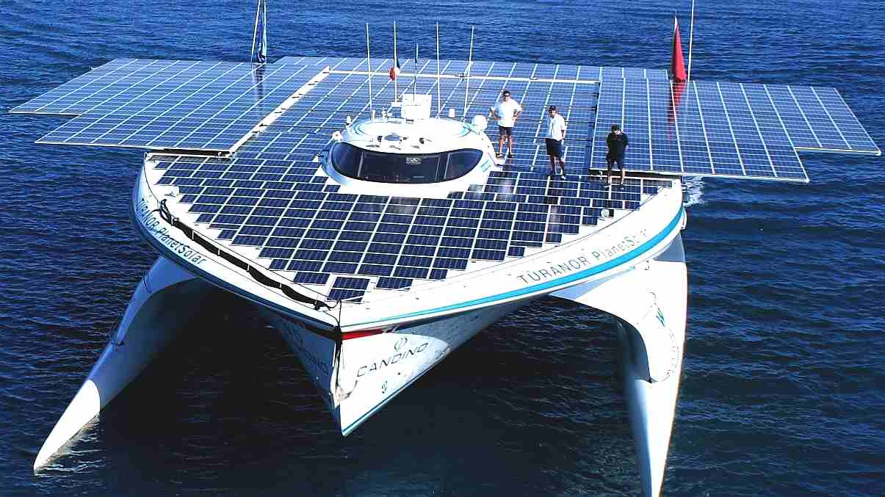
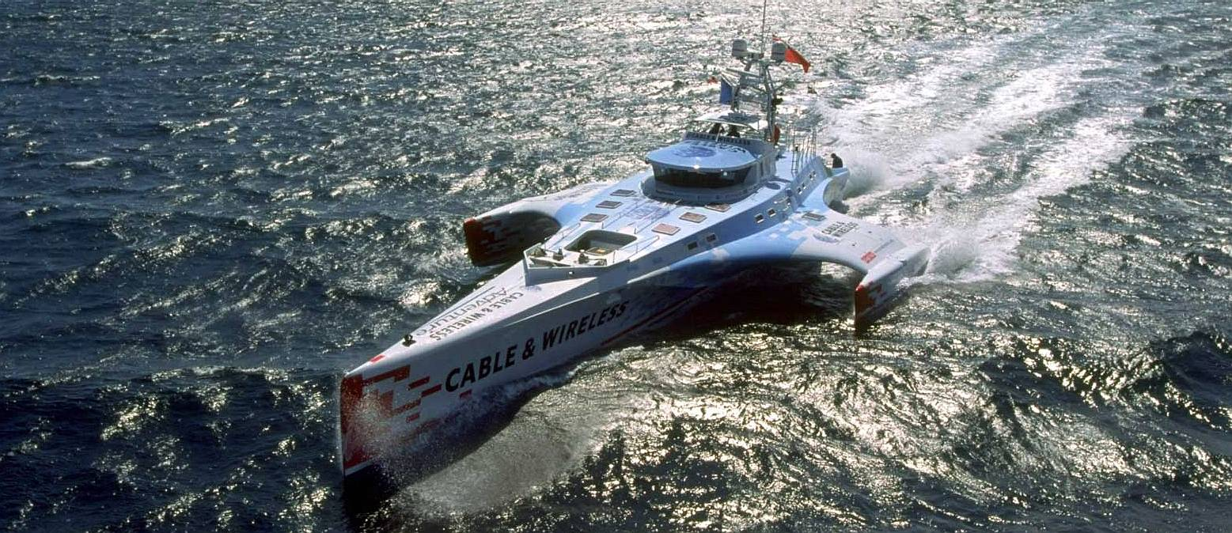
INSPIRATION PLANET SOlar - 2012 1ST World pv Navigation
CABLE & WIRELESS
Diesel Circumnavigation 1998
We aim to prove that a hydrogen powered craft might outperform a diesel ship – long distance. And beat the solar record.
https://elizabethqueenseaswann.com/

Slide 10
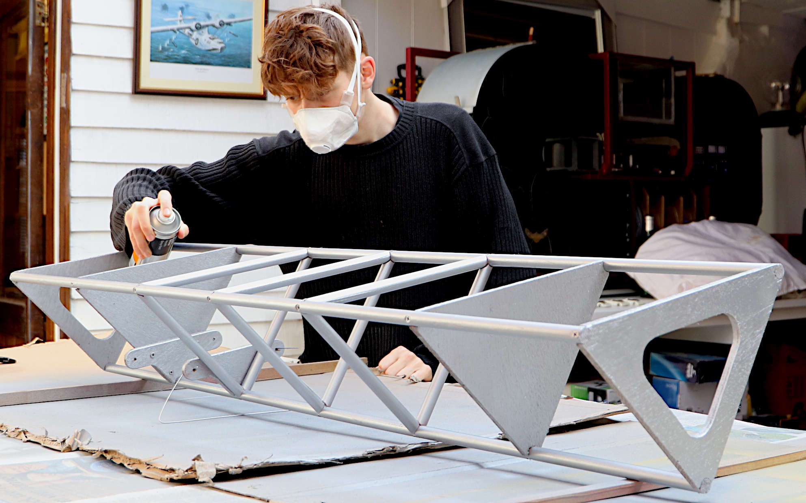
Why I’m passionate
I enjoy a challenge. But, I’m more concerned to help build a secure future for generations to come.
If we are right, hydrogen could be part of the solution to tackle global warming.
We might set a benchmark that proves sustainable marine transport is practical.
The scale of this challenge is both exciting and worth the effort.
https://elizabethqueenseaswann.com/

Slide 11
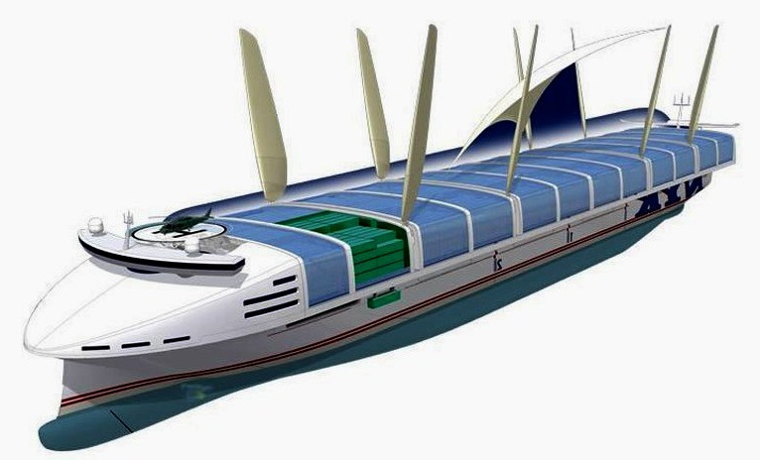
Our future
ZERO CARBON =
CLIMATE FRIENDLY
Having proved the concept, we might move on to help develop yachts, ferries and cargo ships.
We are keen to assist the maritime industry transition to sustainable hydrogen based fuels like methanol – for a clean transport future.
In line with the IMO’s and United Nations’ clean shipping targets.
https://elizabethqueenseaswann.com/

Slide 12
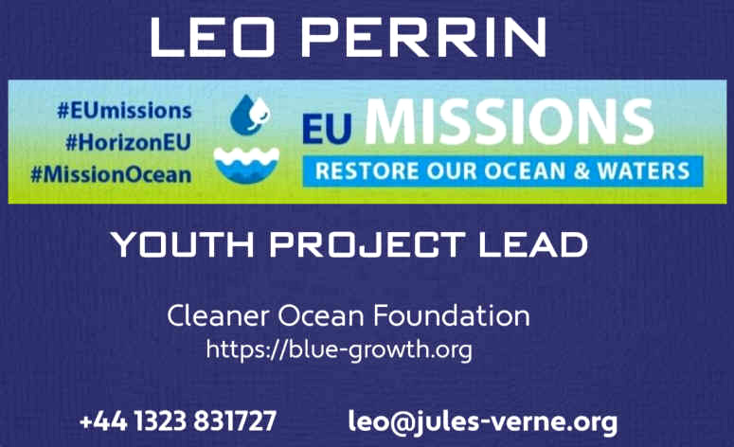
Thank you for listening
Please help to make it happen.
Contact me via our websites or using the email below.
https://elizabethqueenseaswann.com/

